Slide 1
Scan Conversion: Region Filling
Amartya Kundu
Lecturer
CSE, UGV

Slide 2
Region Filling Algorithm
Region Filling algorithms are used to fill the interior of a polygonal shape.
Many algorithms perform fill operations by first identifying the interior points, given the polygon boundary.

Slide 3
Region Filling
Seed Fill Approaches
  2 algorithms: Boundary Fill and Flood Fill
  works at the pixel level
  suitable for interactive painting apllications
Scan-line Fill Approaches
  works at the polygon level
  better performance

Slide 4
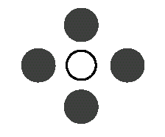
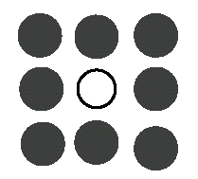
Seed Fill Algorithms: Connectedness
4-connected region: From a given pixel, the region that you can get to by a series of 4 way moves (N, S, E and W)
8-connected region: From a given pixel, the region that you can get to by a series of 8 way moves (N, S, E, W, NE, NW, SE, and SW)
4-connected
8-connected

Slide 5
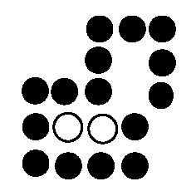
Boundary Fill Algorithm
Start at a point inside a region
Paint the interior outward to the edge
The edge must be specified in a single color
Fill the 4-connected or 8-connected region
4-connected fill is faster, but can have problems:

Slide 6
Boundary Fill Algorithm (cont.)
void BoundaryFill4(int x, int y,
color newcolor, color edgecolor)
{
int current;
current = ReadPixel(x, y);
if(current != edgecolor && current != newcolor)
{
BoundaryFill4(x+1, y, newcolor, edgecolor);
BoundaryFill4(x-1, y, newcolor, edgecolor);
BoundaryFill4(x, y+1, newcolor, edgecolor);
BoundaryFill4(x, y-1, newcolor, edgecolor);
}
}

Slide 7
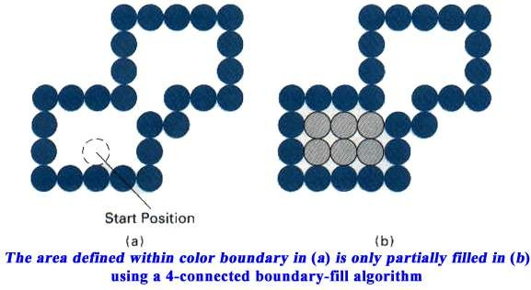
Boundary Fill Algorithm (cont.)

Slide 8
Flood Fill Algorithm
Used when an area defined with multiple color boundaries
Start at a point inside a region
Replace a specified interior color (old color) with fill color
Fill the 4-connected or 8-connected region until all interior points being replaced

Slide 9
Flood Fill Algorithm (cont.)
void FloodFill4(int x, int y, color newcolor, color oldColor)
{
if(ReadPixel(x, y) == oldColor)
{
FloodFill4(x+1, y, newcolor, oldColor);
FloodFill4(x-1, y, newcolor, oldColor);
FloodFill4(x, y+1, newcolor, oldColor);
FloodFill4(x, y-1, newcolor, oldColor);
}
}

Slide 10
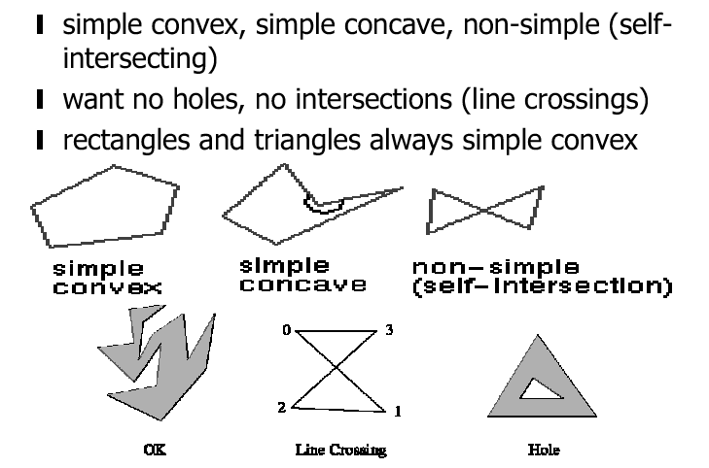
Polygon Types

Slide 11
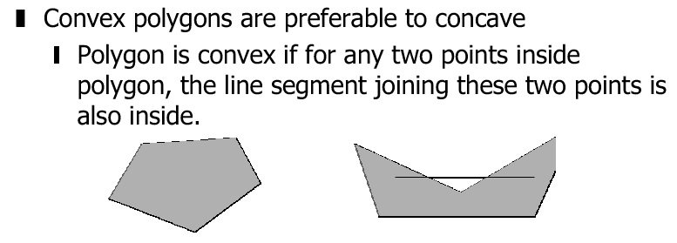
Convex, Concave, Degenerate

Slide 12
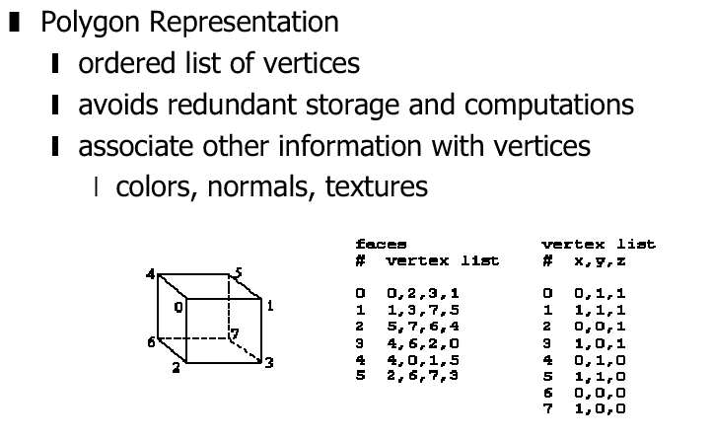
Polygon Representation

Slide 13
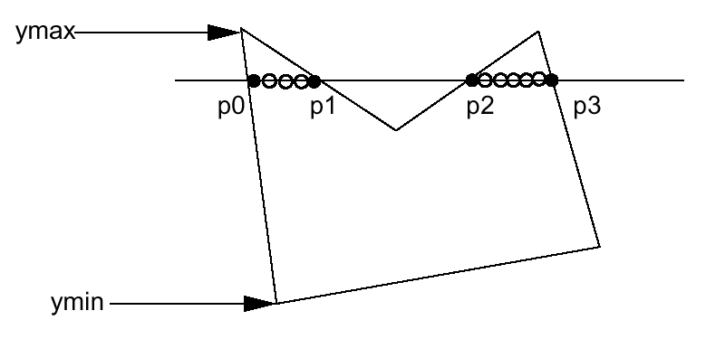
Scanline Fill Algorithm
Intersect scanline with polygon edges
Fill between pairs of intersections
Basic algorithm:
For y = ymin to ymax
1) intersect scanline y with each edge
2) sort intersections by increasing x [p0,p1,p2,p3]
3) fill pairwise (p0->p1, p2->p3, …)

Slide 14
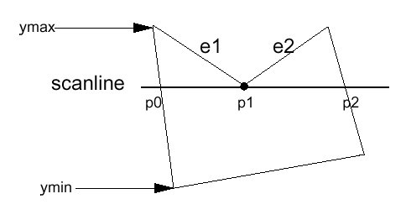
Special Handling
Intersection is an edge end point
Case 1
Intersection points: (p0, p1, p2) ???
->(p0,p1,p1,p2) so we can still fill pairwise
->In fact, if we compute the intersection of the scanline with edge e1 and e2 separately, we will get the intersection point p1 twice. Keep both of the p1.

Slide 15
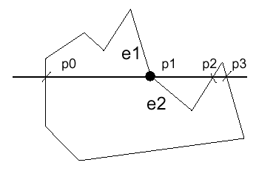
Special Handling (cont.)
Case 2
However, in this case we don’t want to count p1 twice (p0,p1,p1,p2,p3), otherwise we will fill pixels between p1 and p2, which is wrong.

Slide 16
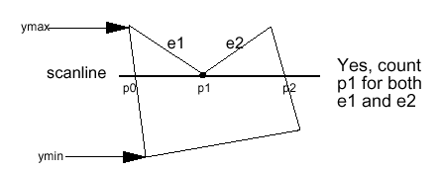
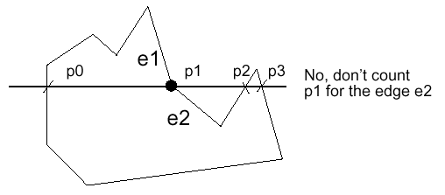
Special Handling (cont.)
Summary: If the intersection is the ymin of the edge’s endpoint, count it. Otherwise, don’t.

Slide 17
Side Effects of Scan Conversion
The most common side effects when working with raster devices are:
Aliasing
Unequal intensity
Overstrike
Picket fence problem

Slide 18
Aliasing
Refers to the plotting of a point in a location other than its true location in order to fit the point into the raster.
Consider equation y = mx + b
For m = 0.5, b = 1 and x = 3 : y = 2.5
So the point (3,2.5) is plotted at alias location (3,3)
Remedy
Apply anti-aliasing algorithms. Most of these algorithms introduce extra pixels and pixels are intensified proportional to the area of that pixel covered by the object.

Slide 19
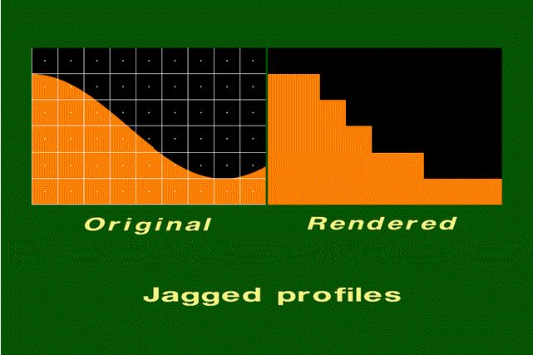
Aliasing

Slide 20
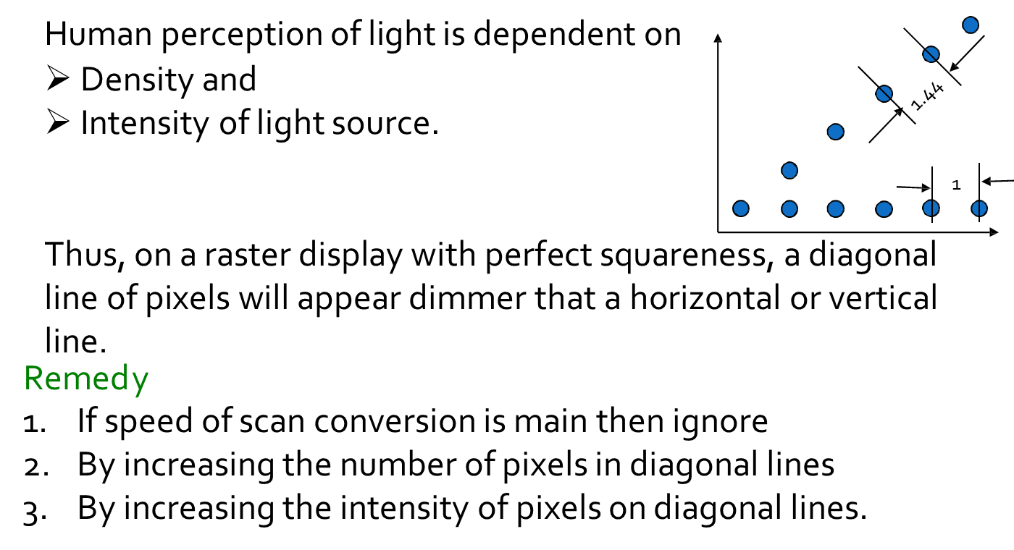
Unequal intensity

Slide 21
Overstrike
The same pixel is written more than once.
This results in intensified pixels in case of photographic media, such as slide or transparency
Remedy
Check each pixel to see whether it has already been written to prior to writing a new point.

Slide 22
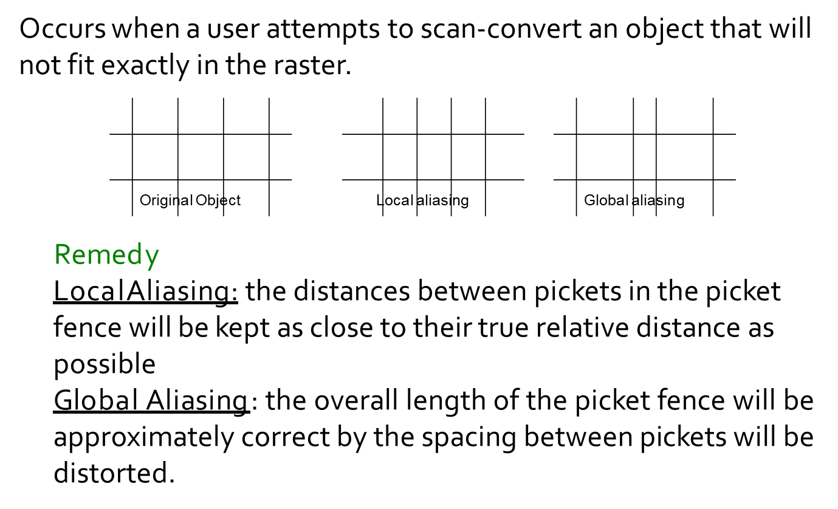
Picket fence problem

Slide 23
Reference
Computer Graphics
  R. Plastock, Zhigang Xiang
  (Schaum’s Outline Series) McGraw Hill

